Slide 1
uygulamalarla yapay zeka 2020280014-Murat -bariscan tosyali

Slide 2
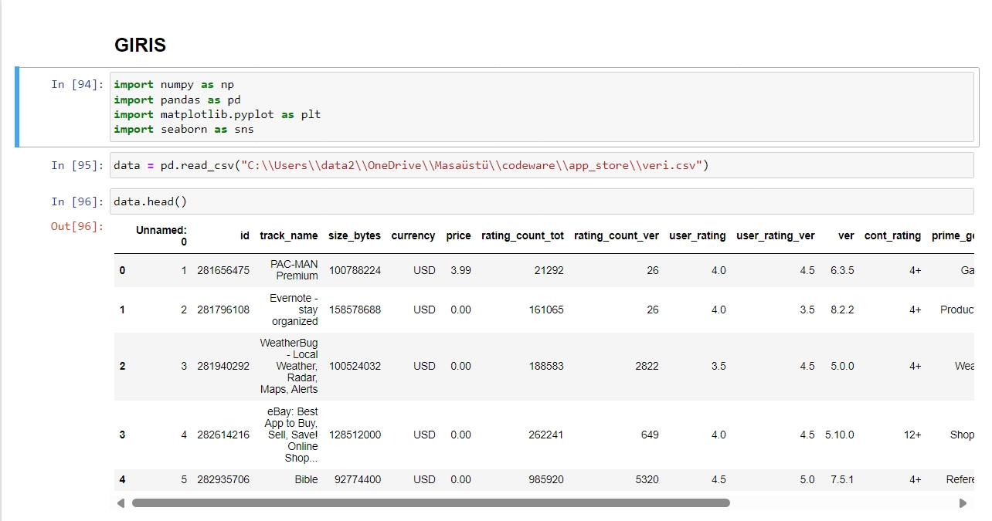

Slide 3
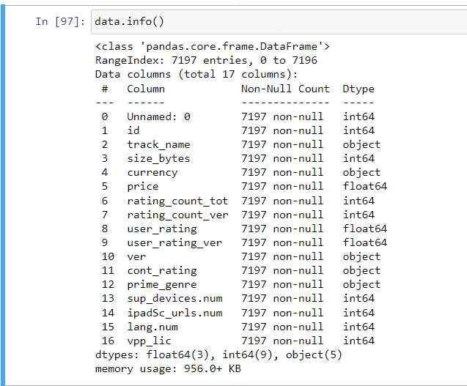

Slide 4
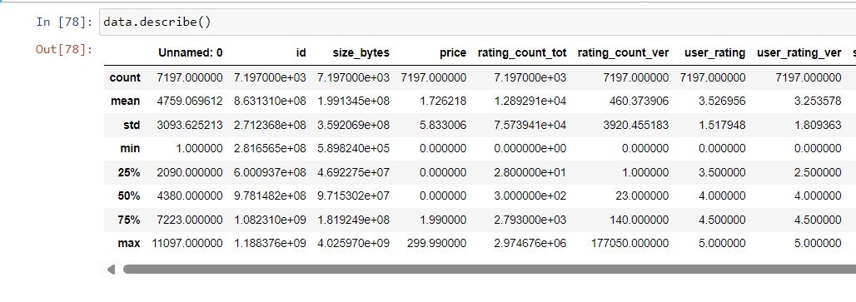

Slide 5
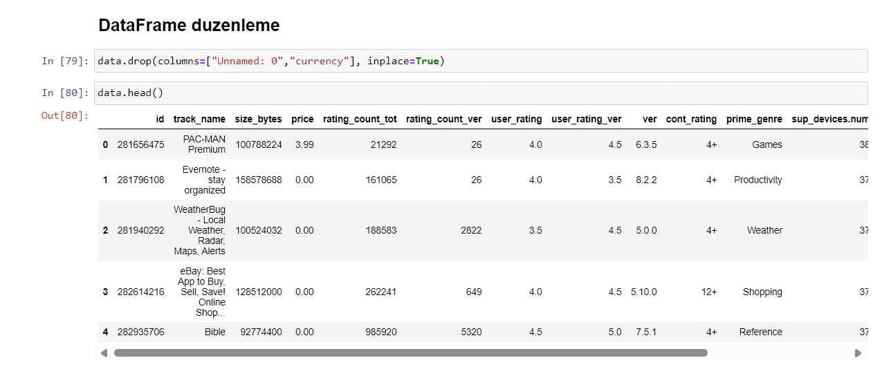

Slide 6
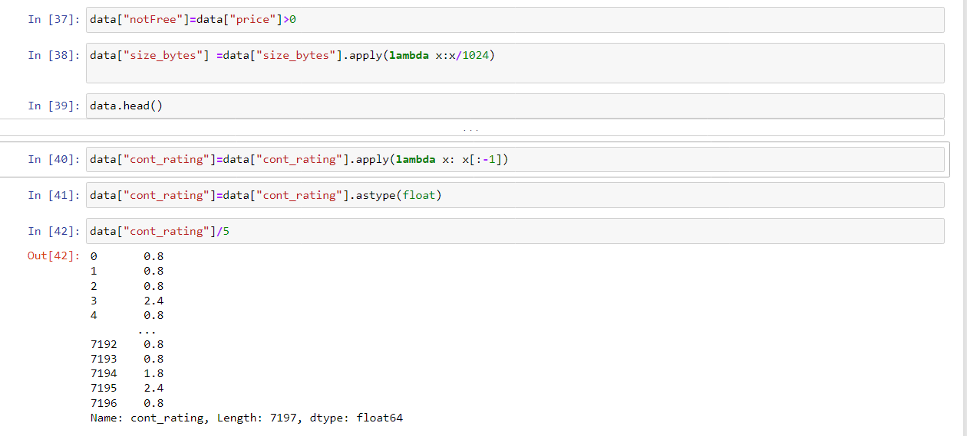
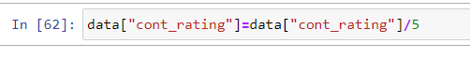

Slide 7
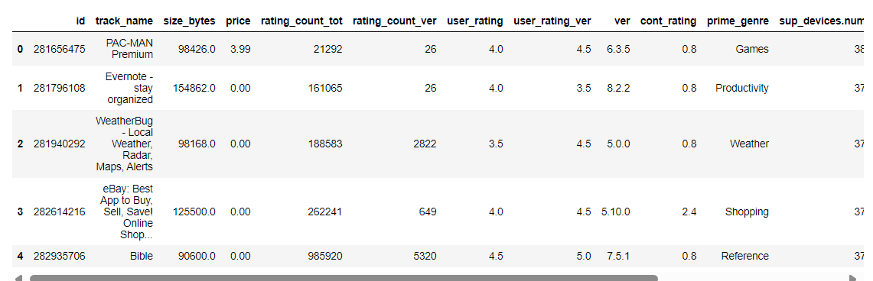





Slide 8
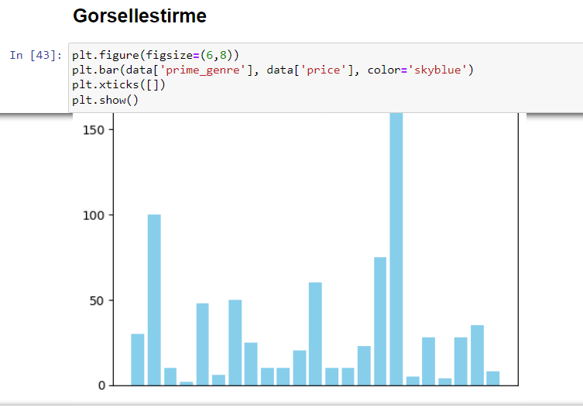

Slide 9
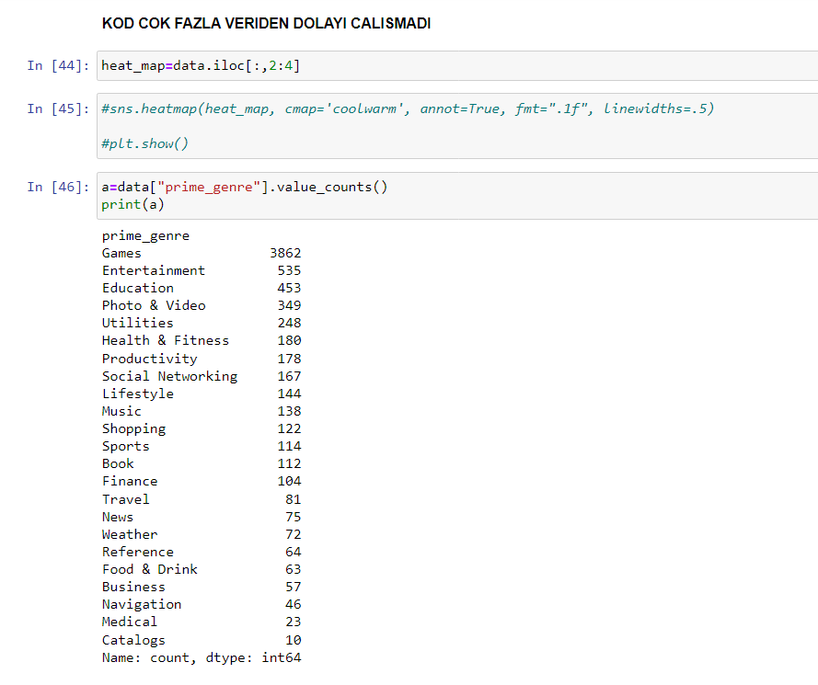
Maintaining composure during the Q&A session is essential for projecting confidence and authority. Consider the following tips for staying composed:
Stay calm
Actively listen
Pause and reflect
Maintain eye contact

Slide 10
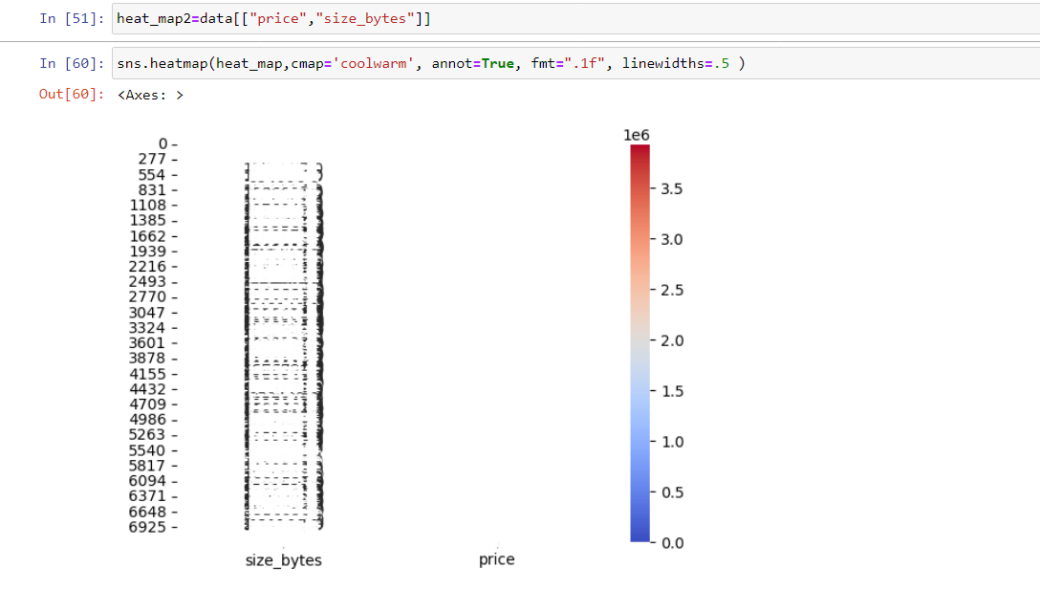

Slide 11
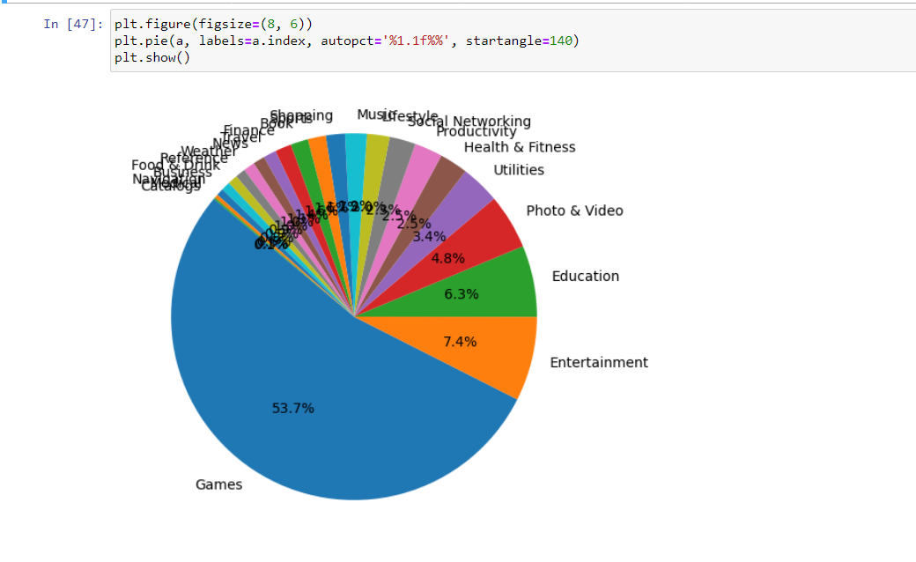
Dynamic delivery
Learn to infuse energy into your delivery to leave a lasting impression
One of the goals of effective communication is to motivate your audience
Metric | Measurement | Target | Actual
Audience attendance | # of attendees | 150 | 120
Engagement duration | Minutes | 60 | 75
Q&A interaction | # of questions | 10 | 15
Positive feedback | Percentage (%) | 90 | 95
Rate of information retention | Percentage (%) | 80 | 85

Slide 12
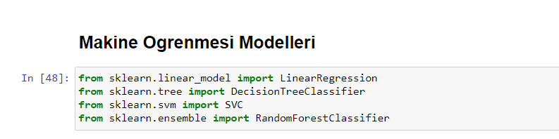
Thank you

